Slide 1
Introduction to Machine Learning ARM-206

Slide 2
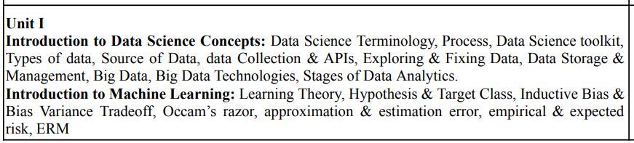
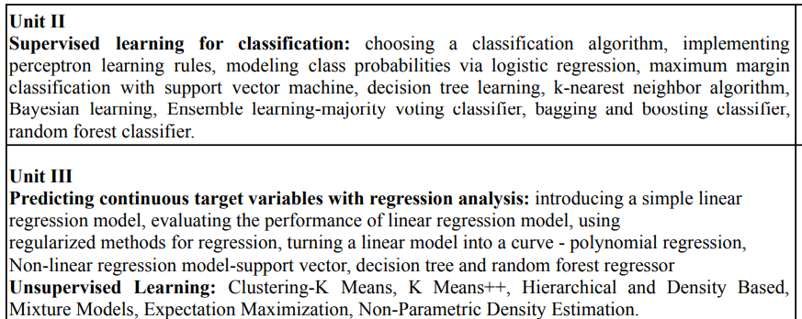
SYLLABUS

Slide 3
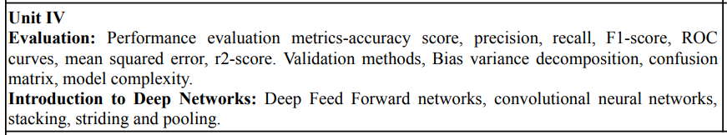
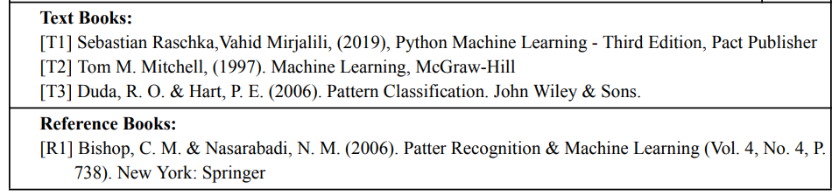
SYLLABUS

Slide 4
UNIT-1 Introduction to Machine Learning

Slide 5
Ever since computers were invented, we have wondered whether they might be made to learn.
If we could understand how to program them to learn-to improve automatically with experience-the impact would be dramatic.
Imagine computers
learning from medical records which treatments are most effective for new diseases,
houses learning from experience to optimize energy costs based on the particular usage patterns of their occupants,
personal software assistants learning the evolving interests of their users in order to highlight especially relevant stories from the online morning newspaper.

Slide 6
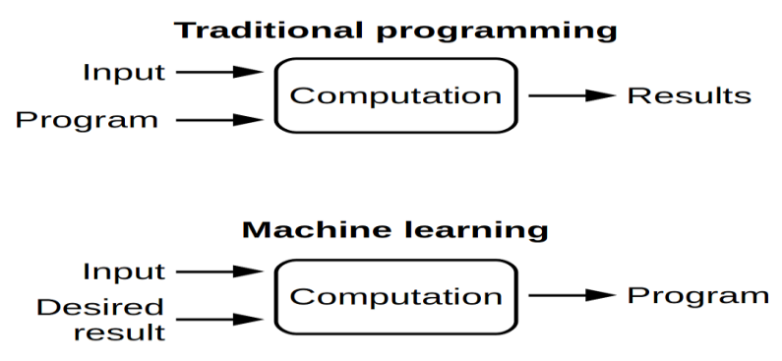
What is Machine learning?
Machine Learning was coined in 1959 by Arthur Samuel, an American IBMer and pioneer in the field of computer gaming and artificial intelligence.
“Machine learning is the science of getting computers to perform tasks without being explicitly programmed.”
It’s a subset of AI which uses statistical methods to enable machines to improve with experience.
Machine learning involves computers discovering how they can act without being explicitly programmed to do so. It involves computers learning from data provided so that they carry out certain tasks.

Slide 7
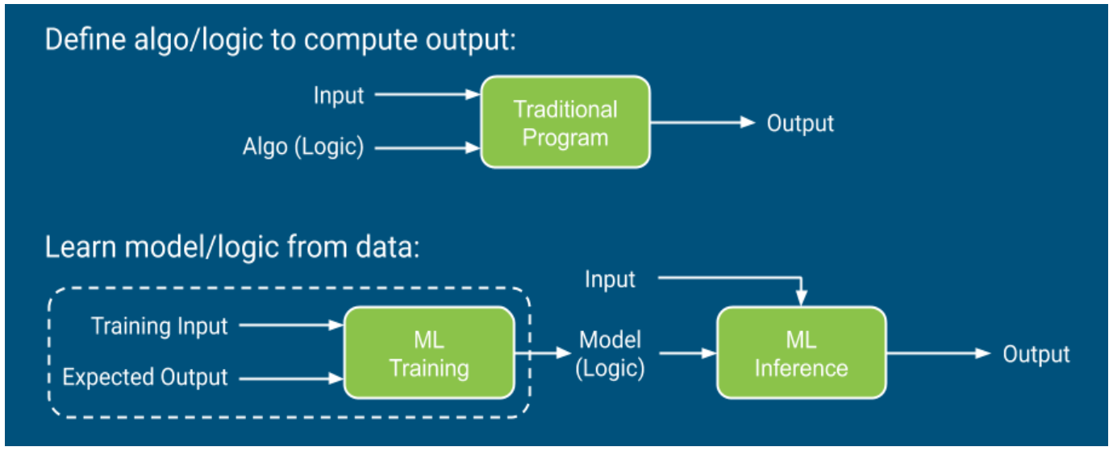
What is Machine learning?

Slide 8
Some successful applications of machine learning
Learning to recognize spoken words.
All of the most successful speech recognition systems employ machine learning in some form.
For example, the SPHINX system (e.g., Lee 1989) learns speaker-specific strategies for recognizing the primitive sounds (phonemes) and words from the observed speech signal.
Neural network learning methods (e.g., Waibel et al. 1989) and methods for learning hidden Markov models(e.g., Lee 1989) are effective for automatically customizing to, individual speakers, vocabularies, microphone characteristics, background noise, etc.
Learning to drive an autonomous vehicle.
Machine learning methods have been used to train computer-controlled vehicles to steer correctly when driving on a variety of road types.
For example, the ALVINN system (Pomerleau 1989) has used its learned strategies to drive unassisted at 70 miles per hour for 90 miles on public highways among other cars.

Slide 9
Some successful applications of machine learning
Learning to classify new astronomical structures.
Machine learning methods have been applied to a variety of large databases to learn general regularities implicit in the data.
For example, decision tree learning algorithms have been used by NASA to learn how to classify celestial objects from the second Palomar Observatory Sky Survey (Fayyad et al. 1995). This system is now used to automatically classify all objects in the Sky Survey, which consists of three terra bytes of image data.
Learning to play world-class backgammon.
The most successful computer programs for playing games such as backgammon are based on machine learning algorithms.
For example, the world's top computer program for backgammon, TD-GAMMON (T esauro 1992, 1995). learned its strategy by playing over one million practice games against itself. It now plays at a level competitive with the human world champion.

Slide 10
Some disciplines and examples of their influence on machine learning.
Artificial intelligence
Learning symbolic representations of concepts. Machine learning as a search problem. Learning as an approach to improving problem solving. Using prior knowledge together with training data to guide learning.
Bayesian methods
Bayes' theorem as the basis for calculating probabilities of hypotheses. The naive Bayes classifier. Algorithms for estimating values of unobserved variables.
Computational complexity theory
Theoretical bounds on the inherent complexity of different learning tasks, measured in terms of the computational effort, number of training examples, number of mistakes, etc. required in order to learn.
Control theory
Procedures that learn to control processes in order to optimize predefined objectives and that learn to predict the next state of the process they are controlling.
Information theory
Measures of entropy and information content. Minimum description length approaches to learning. Optimal codes and their relationship to optimal training sequences for encoding a hypothesis.
Philosophy
Occam's razor, suggesting that the simplest hypothesis is the best. Analysis of the justification for generalizing beyond observed data.
Psychology and neurobiology
The power law of practice, which states that over a very broad range of learning problems, people's response time improves with practice according to a power law. Neurobiological studies motivating artificial neural network models of learning.
Statistics
Characterization of errors (e.g., bias and variance) that occur when estimating the accuracy of a hypothesis based on a limited sample of data. Confidence intervals, statistical tests.

Slide 11
WELL-POSED LEARNING PROBLEMS
A computer program is said to learn from experience E with respect to some class of tasks T and performance measure P, if its performance at tasks in T, as measured by P, improves with experience E.
To have a well-defined learning problem, we must identity these three features:
1. the class of tasks
2. the measure of performance to be improved
3. the source of experience.

Slide 12
WELL-POSED LEARNING PROBLEMS
A checkers learning problem:
• Task T: playing checkers
• Performance measure P: percent of games won against opponents • Training experience E: playing practice games against itself
A handwriting recognition learning problem:
• Task T: recognizing and classifying handwritten words within images
• Performance measure P: percent of words correctly classified •Training experience E: a database of handwritten words with given classifications
A robot driving learning problem:
•Task T: driving on public four-lane highways using vision sensors •Performance measure P: average distance travelled before an error (as judged by human overseer)
• Training experience E: a sequence of images and steering commands recorded while observing a human driver

Slide 13
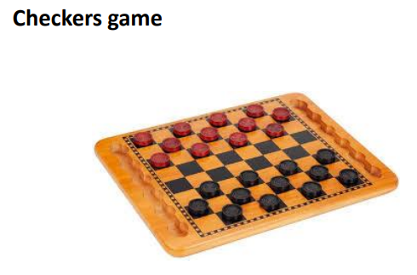
WELL-POSED LEARNING PROBLEMS

Slide 14
CHECKERS GAME
About game
•Classic Checkers is played by two players. Each player begins the game with 12 colored discs. (Typically, one set of pieces is black and the other white.)
• The board consists of 64 squares, alternating between 32 dark and 32 light squares. It is positioned so that each player has a light square on the right side corner closest to him or her.
•A player wins the game when the opponent cannot make a move. In most cases, this is because all of the opponent's pieces have been captured, but it could also be because all of his pieces are blocked in.

Slide 15
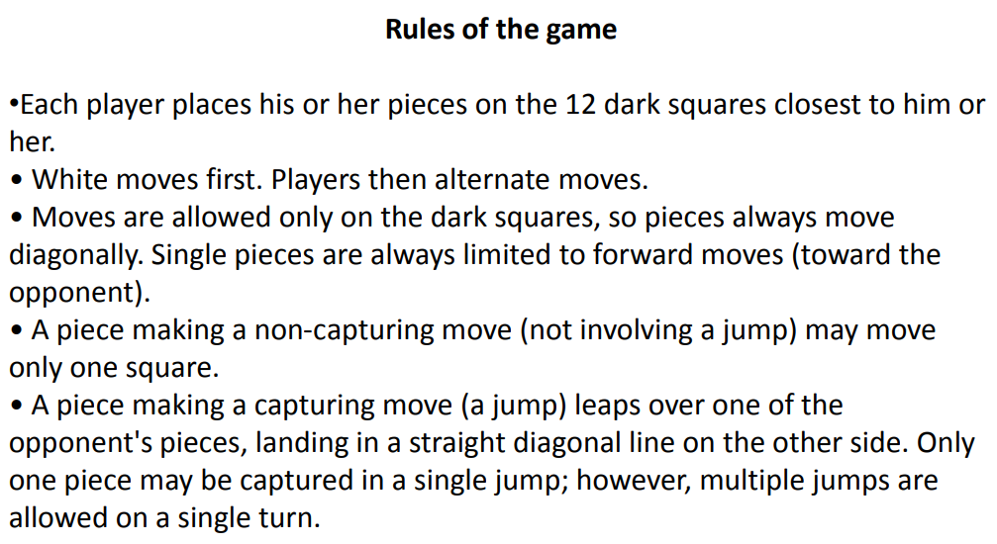
CHECKERS GAME

Slide 16
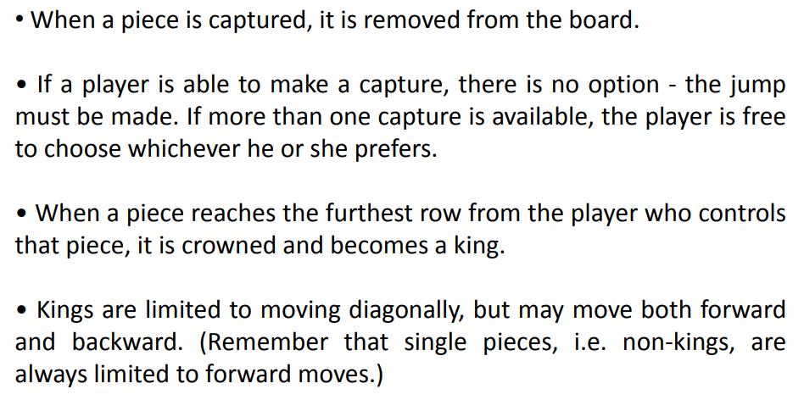
CHECKERS GAME Rules Contd…

Slide 17
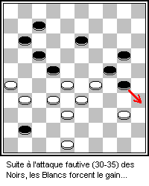

Slide 18
DESIGNING A LEARNING SYSTEM
Choosing the Training Experience
Choosing the Target Function
Choosing a Representation for the Target Function
Choosing a Function Approximation Algorithm
1. Estimating training values
2. Adjusting the weights
5. The Final Design
To illustrate some of the basic design issues and approaches to machine learning, let us consider designing a program to learn to play checkers, with the goal of entering it in the world checkers tournament.

Slide 19
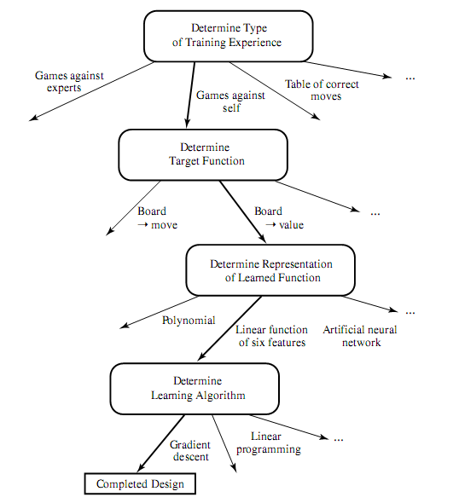
The Final Design

Slide 20
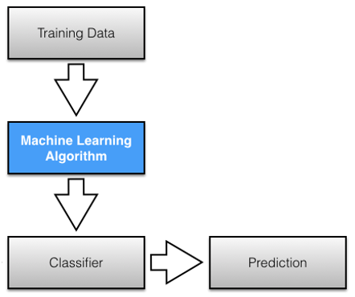
The central dogma (concepts) of ML

Slide 21
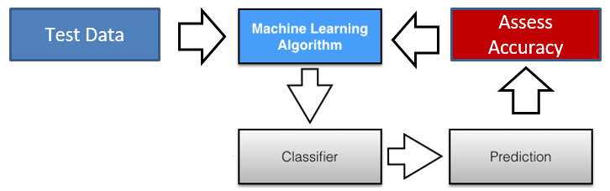
The central dogma (concepts) of ML

Slide 22
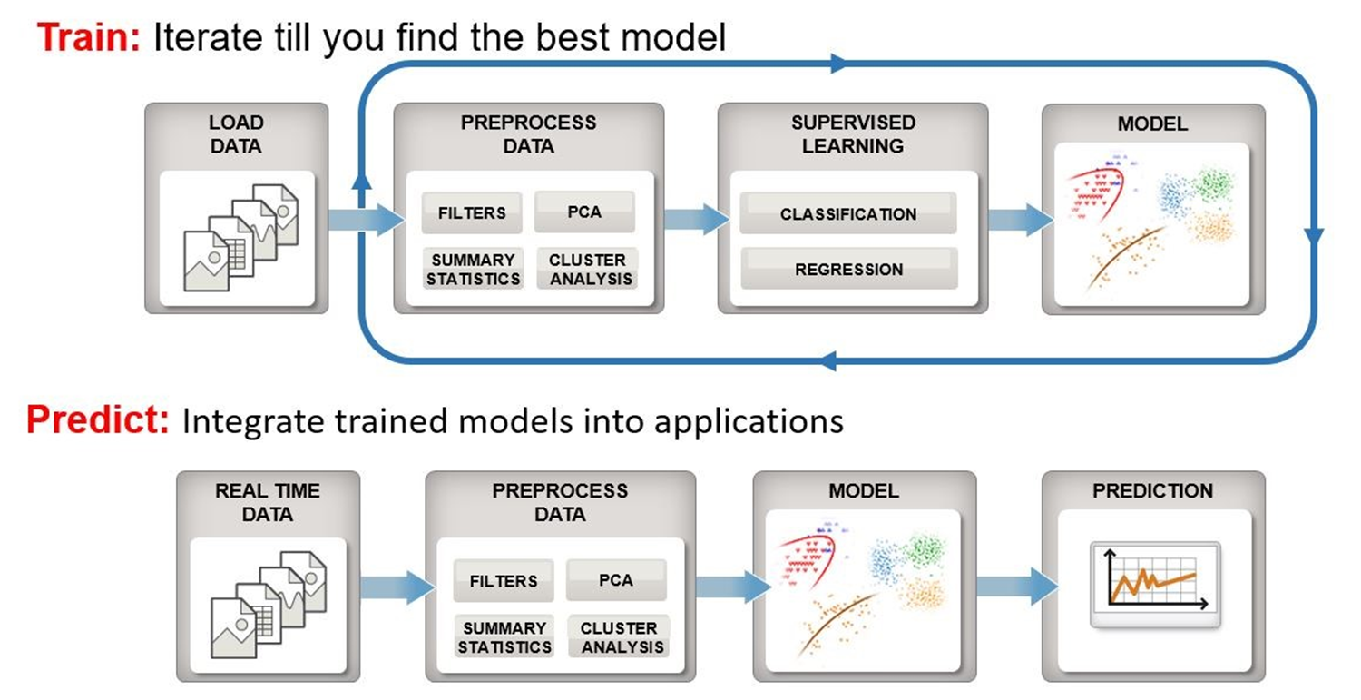
The central dogma (concepts) of ML

Slide 23
Some Issues in Machine Learning
The field of machine learning is concerned with answering questions such as the following
• What algorithms exist for learning general target functions from specific training examples? In what settings will particular algorithms converge to the desired function, given sufficient training data? Which algorithms perform best for which types of problems and representations?
• How much training data is sufficient? What general bounds can be found to relate the confidence in learned hypotheses to the amount of training experience and the character of the learner's hypothesis space?
•When and how can prior knowledge held by the learner guide the process of generalizing from examples? Can prior knowledge be helpful even when it is only approximately correct?

Slide 24
Some Issues in Machine Learning contd…
•What is the best strategy for choosing a useful next training experience, and how does the choice of this strategy alter the complexity of the learning problem?
• What is the best way to reduce the learning task to one or more function approximation problems? Put another way, what specific functions should the system attempt to learn? Can this process itself be automated?
• How can the learner automatically alter its representation to improve its ability to represent and learn the target function?

Slide 25
When Do We Need Machine Learning?
experience: the problem’s complexity Tasks That Are Too Complex to Program.
Tasks Performed by Animals/Humans:
driving, speech recognition, and image understanding.
Tasks beyond Human Capabilities:
analysis of very large and complex data sets: astronomical data, turning medical archives into medical knowledge, weather prediction, analysis of genomic data, Web search engines, and electronic commerce.
Need for Adaptivity.
programs that decode handwritten text, where a fixed program can adapt to variations between the handwriting of different users; spam detection programs, adapting automatically to changes in the nature of spam e-mails; and speech recognition programs.

Slide 26
When Do We Need Machine Learning?
Machine Learning is used when:
•Human expertise does not exist (navigating on Mars)
•Humans are unable to explain their expertise (speech recognition) •Solution changes with time (routing on a computer network) •Solution needs to be adapted to particular cases (user biometrics)

Slide 27
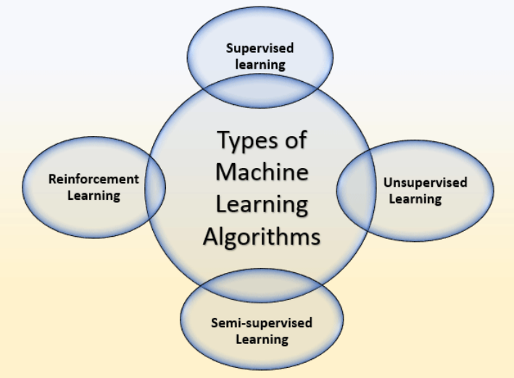
Types of Machine Learning

Slide 28
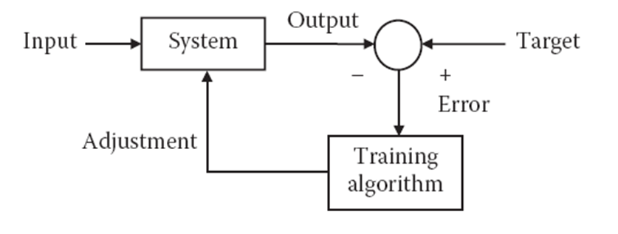
Types of Machine Learning contd…
• Supervised learning : In this kind of learning, both the inputs and the outputs are well determined and supplied to the training algorithm. Hence whenever an input is applied, we can calculate the error. We try to adjust the weights in such a way that this error is reduced.

Slide 29
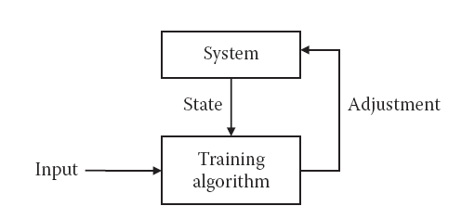
Types of Machine Learning contd…
• Unsupervised learning: In this type of learning, the target outputs are unknown. The inputs are applied, and the system is adjusted based on these inputs only. Either the supporting weights of the problem are added or the dissipative nodes are decreased. In either case, the system changes according to the inputs.

Slide 30
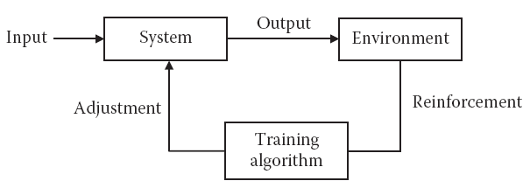
Types of Machine Learning contd…
• Reinforcement learning: This type of learning is based on the reinforcement process. In this system, the input is applied. Based on the output, the system either gives some reward to the network or punishes the network. In this learning technique, the system tries to maximize the rewards and minimize the punishment. The basic block diagram is given

Slide 31
Types of Machine Learning contd…
Semi-Supervised Machine Learning
Semi-Supervised learning is a type of Machine Learning algorithm that represents the intermediate ground between Supervised and Unsupervised learning algorithms.
It uses the combination of labeled and unlabeled datasets during the training period.
we train the model with a less labeled dataset.
Speech Analysis
Web content classification
Text document classifier
Protein sequence classification

Slide 32
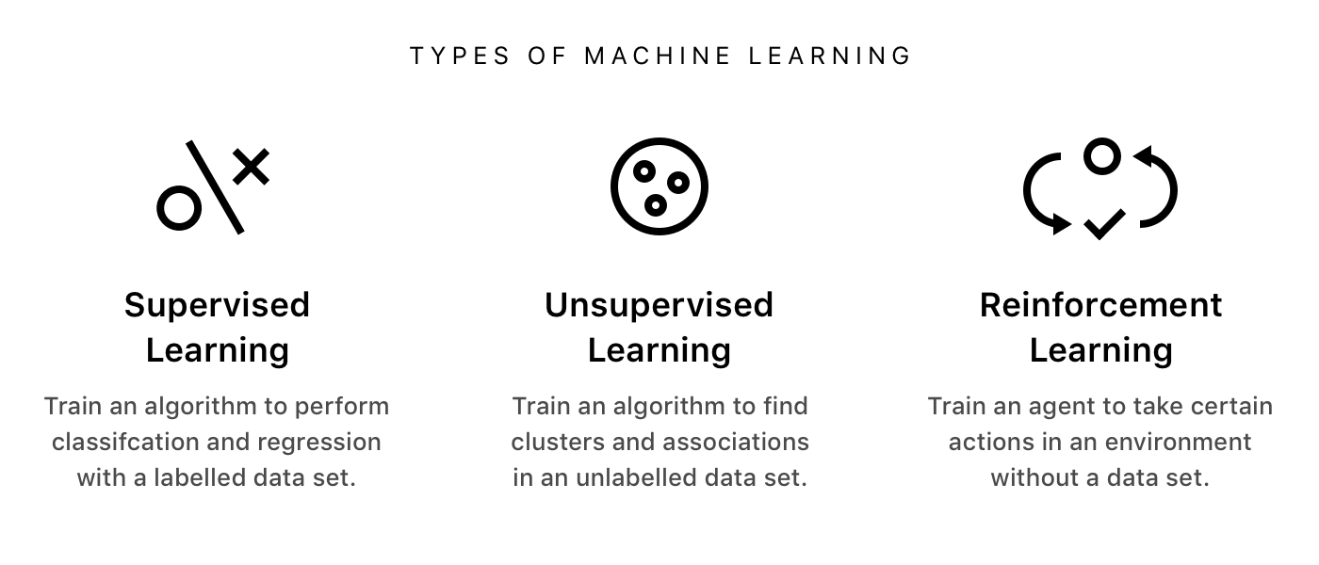
Types of Machine Learning contd…

Slide 33
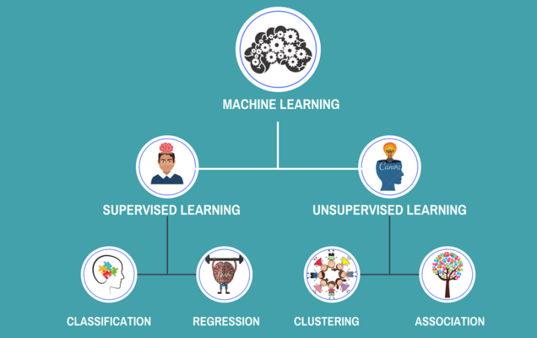
Types of Machine Learning contd…

Slide 34
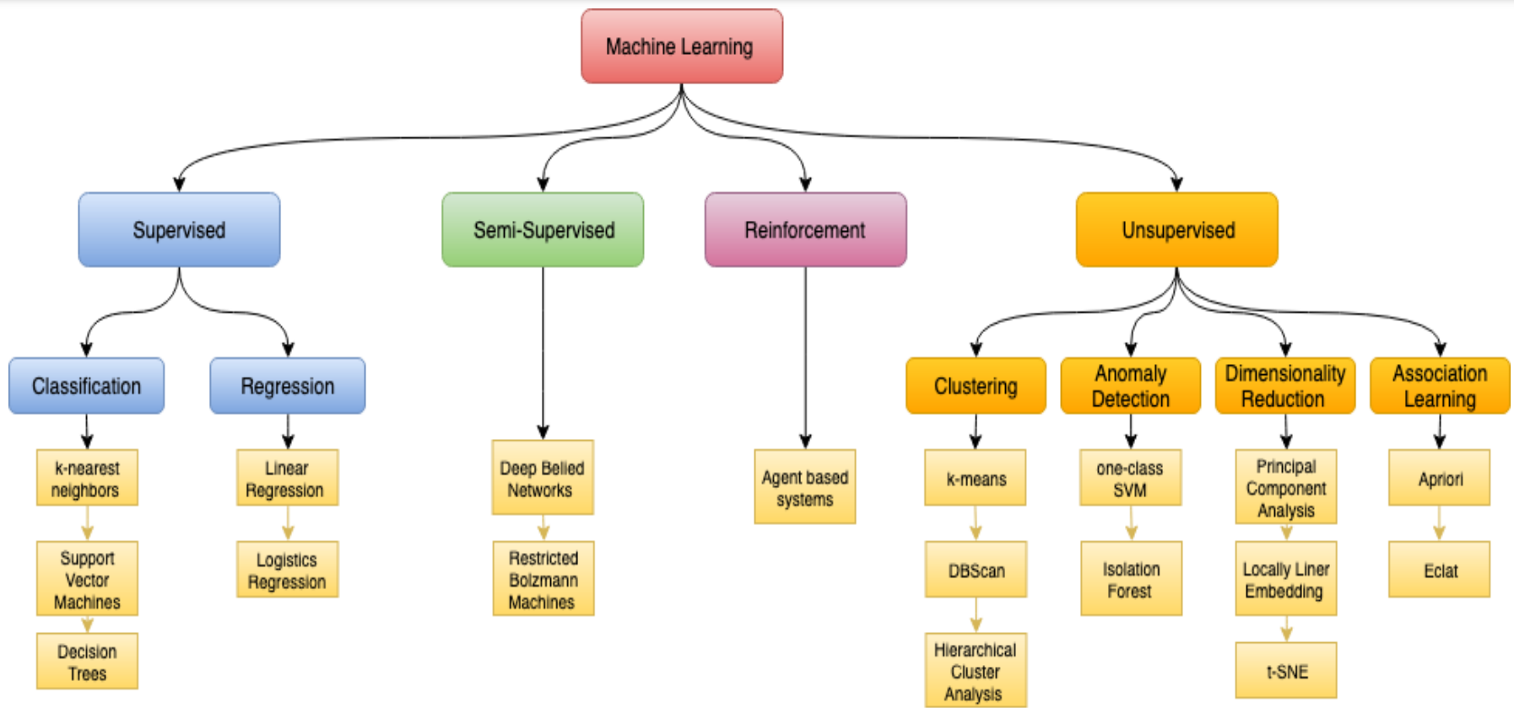
Types of Machine Learning contd…

Slide 35
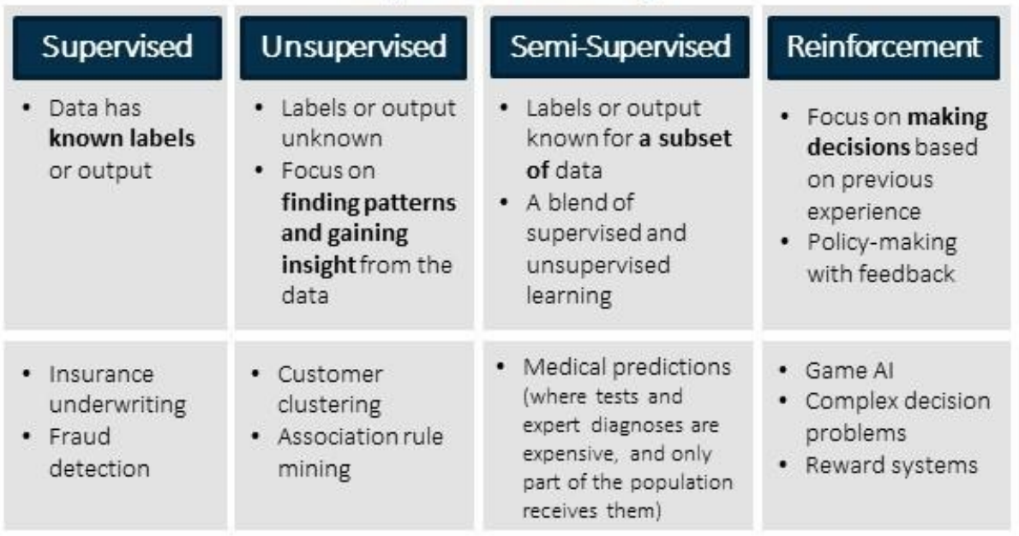
Types of Machine Learning contd…

Slide 36
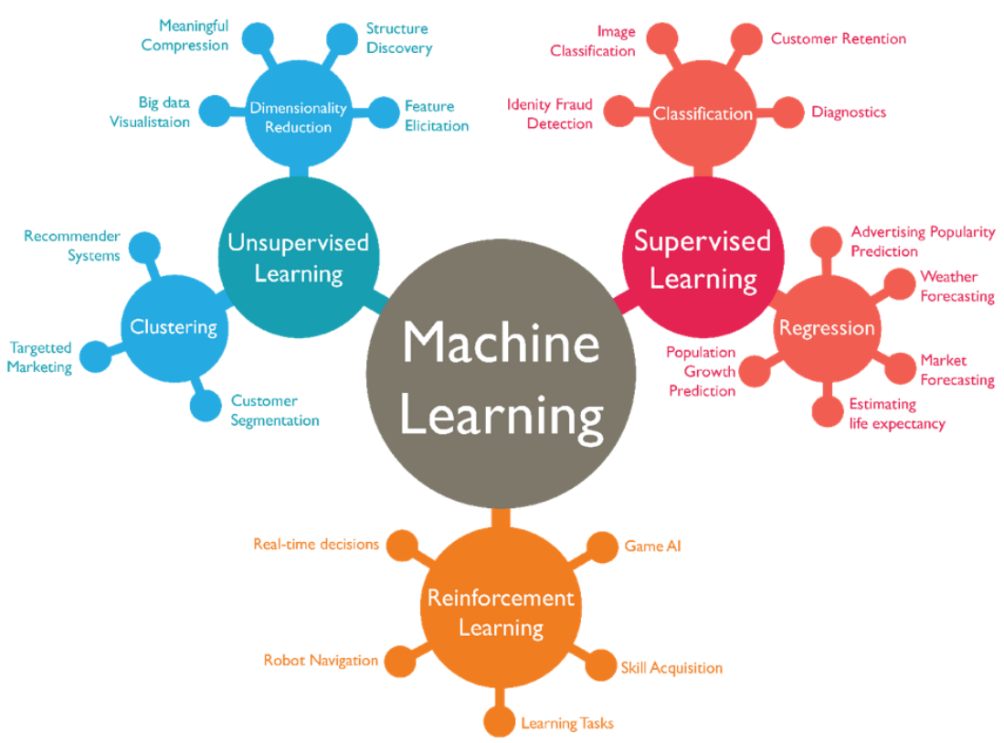
Types of Machine Learning contd…

Slide 37
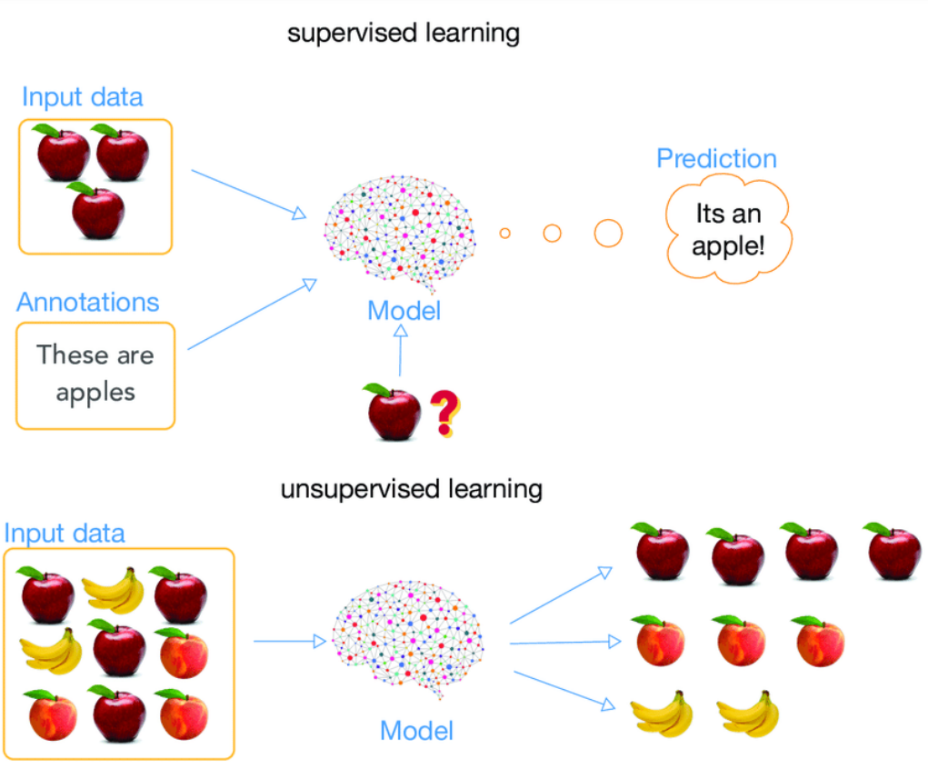
Types of Machine Learning contd…

Slide 38
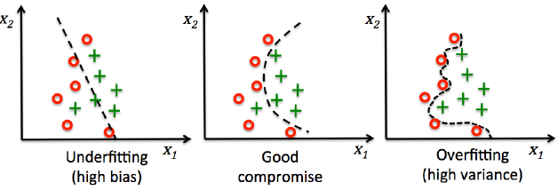
Over-fitting and Under-fitting
Note:
Bias measures how far off the predictions from the correct values.
Variance measures the consistency of the model prediction for a particular sample instance

Slide 39
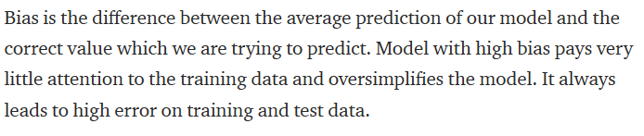
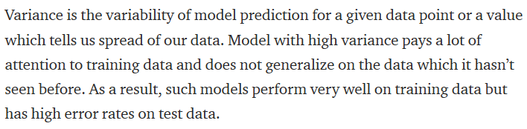
What is Bias?
What is Variance?

Slide 40
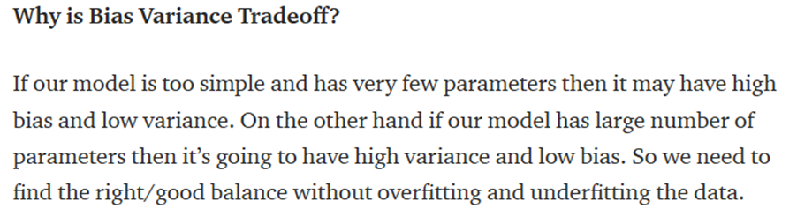
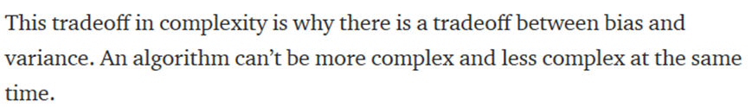
Bias-Variance Tradeoff

Slide 41
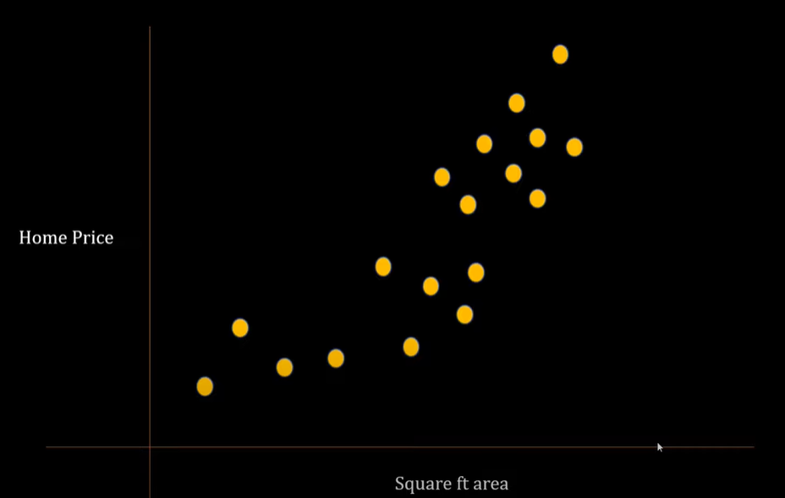
Bias-Variance Tradeoff

Slide 42
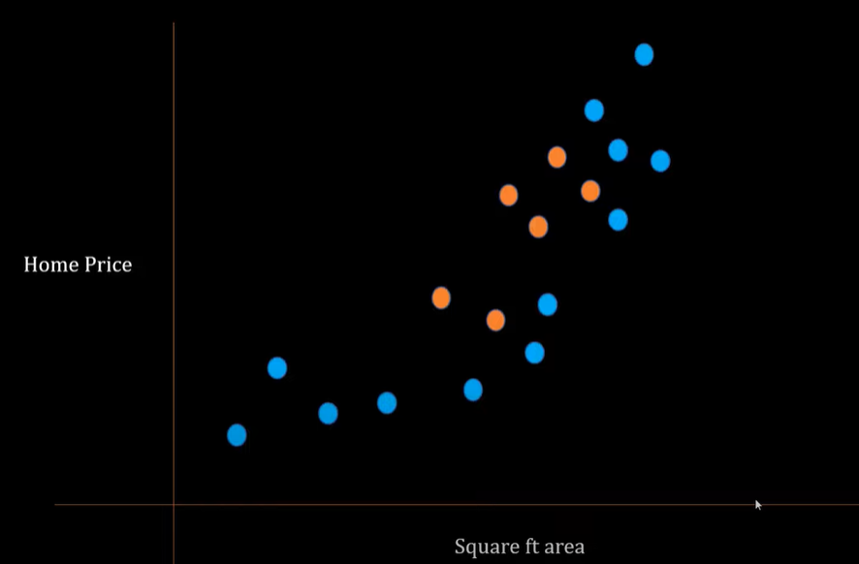
Bias-Variance Tradeoff
Blue Dots = Training Sample, Orange Dots = Test Sample

Slide 43
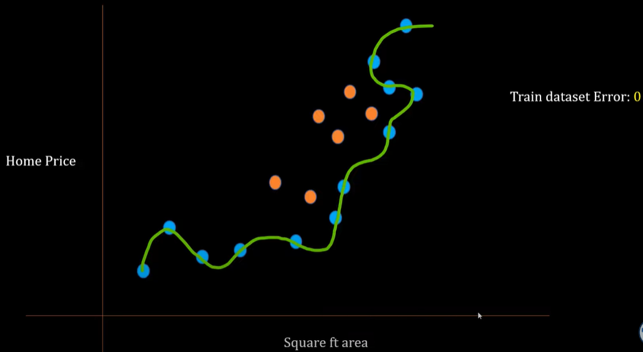
Bias-Variance Tradeoff
Model Overfits the training pattern

Slide 44
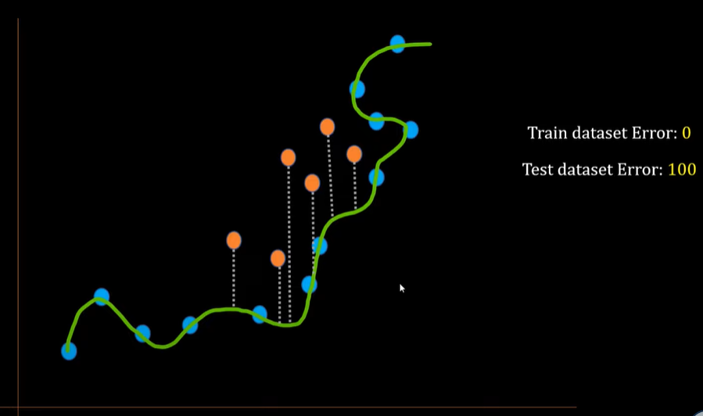
Bias-Variance Tradeoff

Slide 45
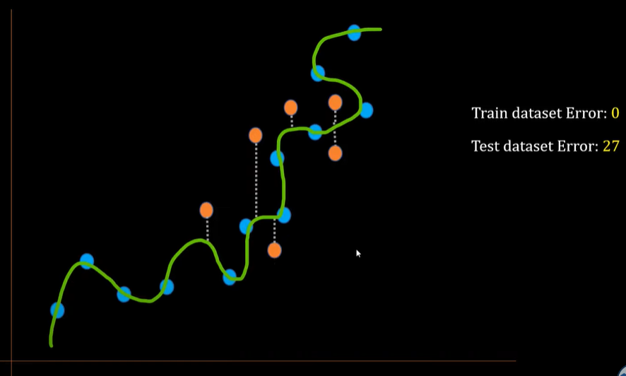
Bias-Variance Tradeoff
For different training and testing sample points

Slide 46
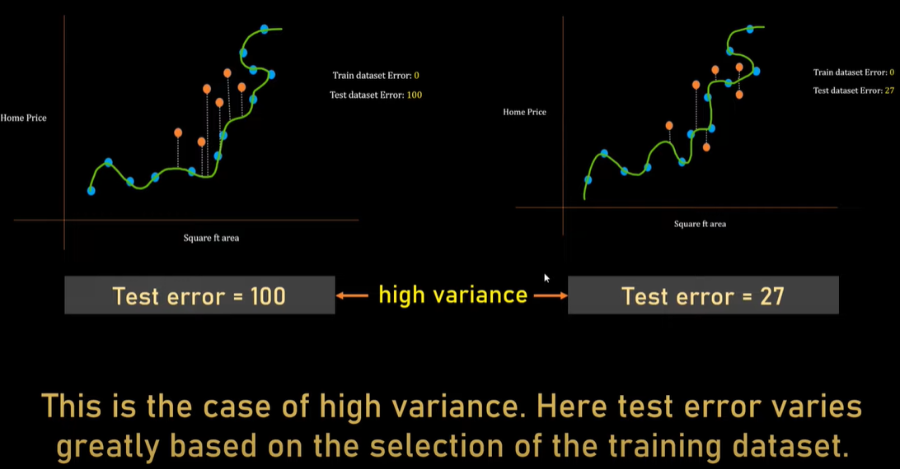
Bias-Variance Tradeoff

Slide 47
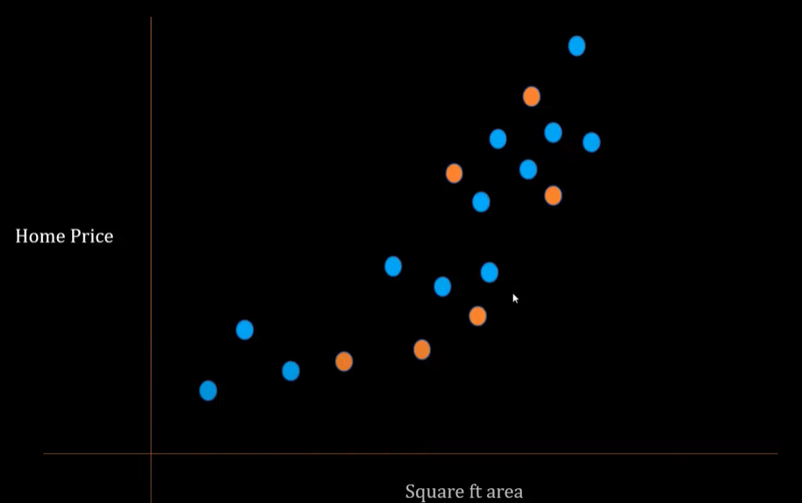
Bias-Variance Tradeoff
Other case…

Slide 48
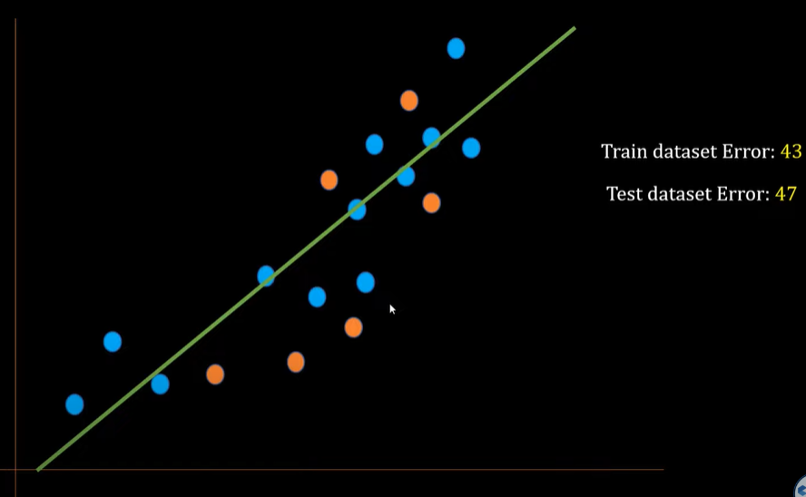
Bias-Variance Tradeoff

Slide 49
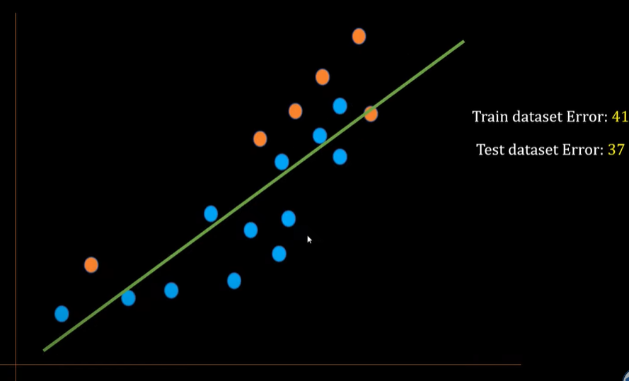
Bias-Variance Tradeoff
If another researcher take another set of training and test sample data points

Slide 50
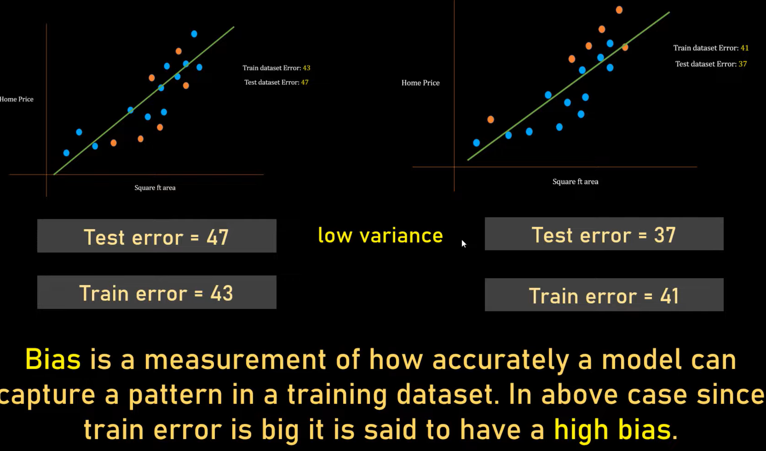
Bias-Variance Tradeoff

Slide 51
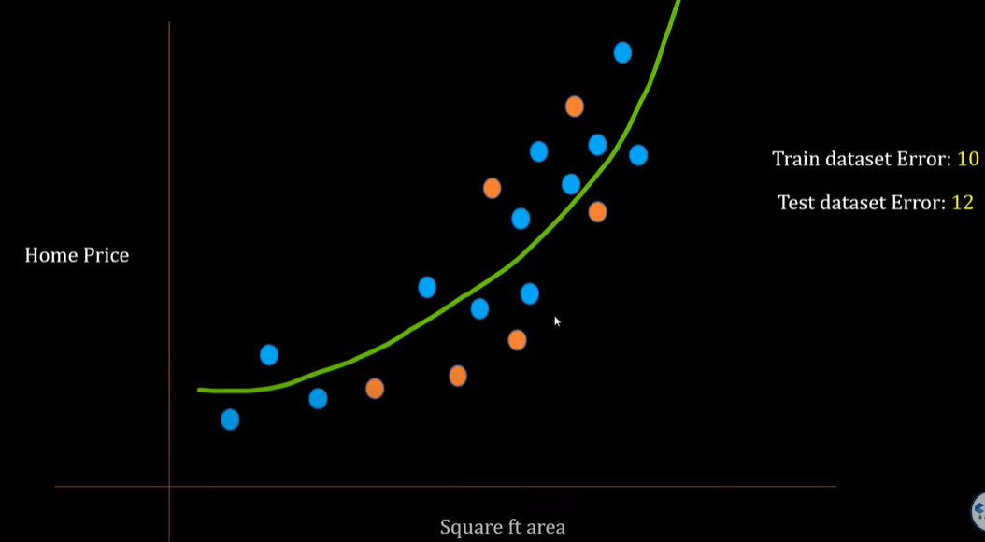
Bias-Variance Tradeoff
Third Case…

Slide 52
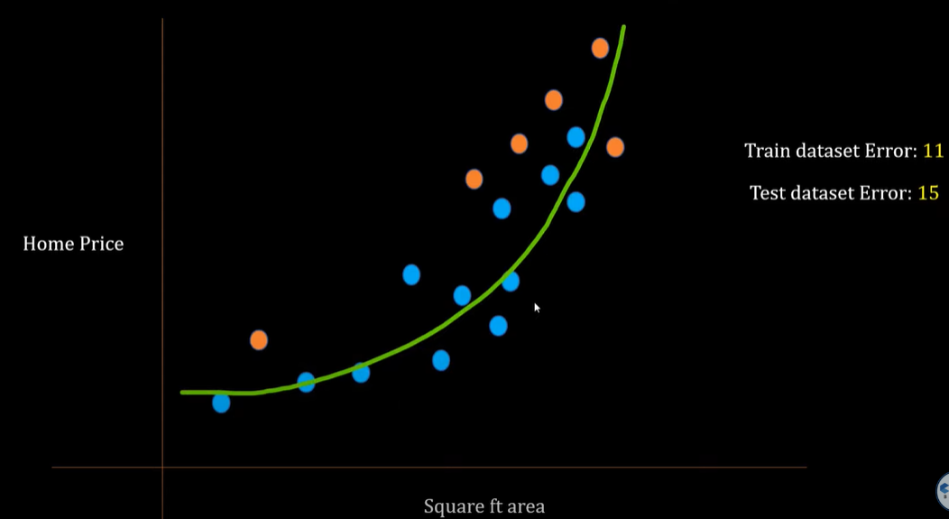
Bias-Variance Tradeoff
For different data points

Slide 53
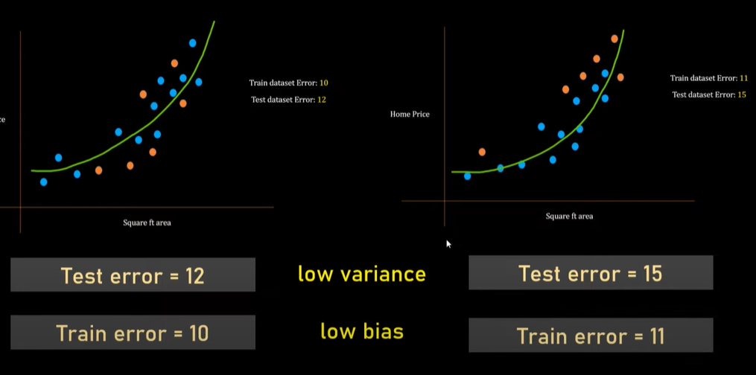
Bias-Variance Tradeoff

Slide 54
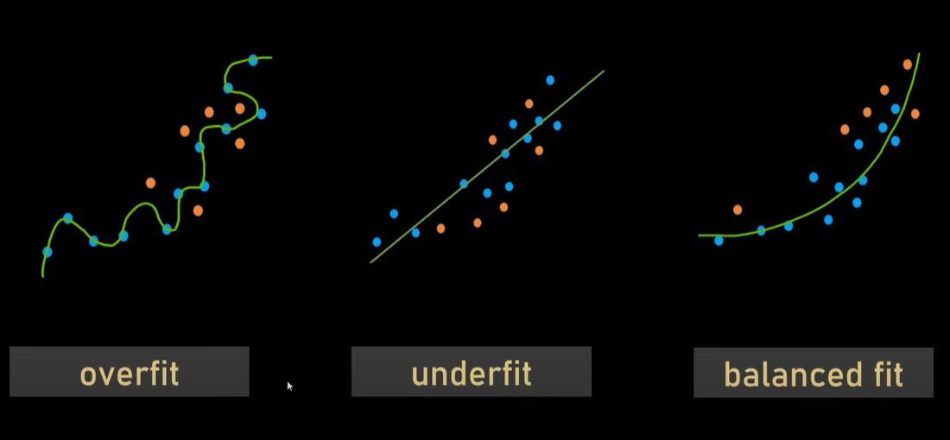
Bias-Variance Tradeoff

Slide 55
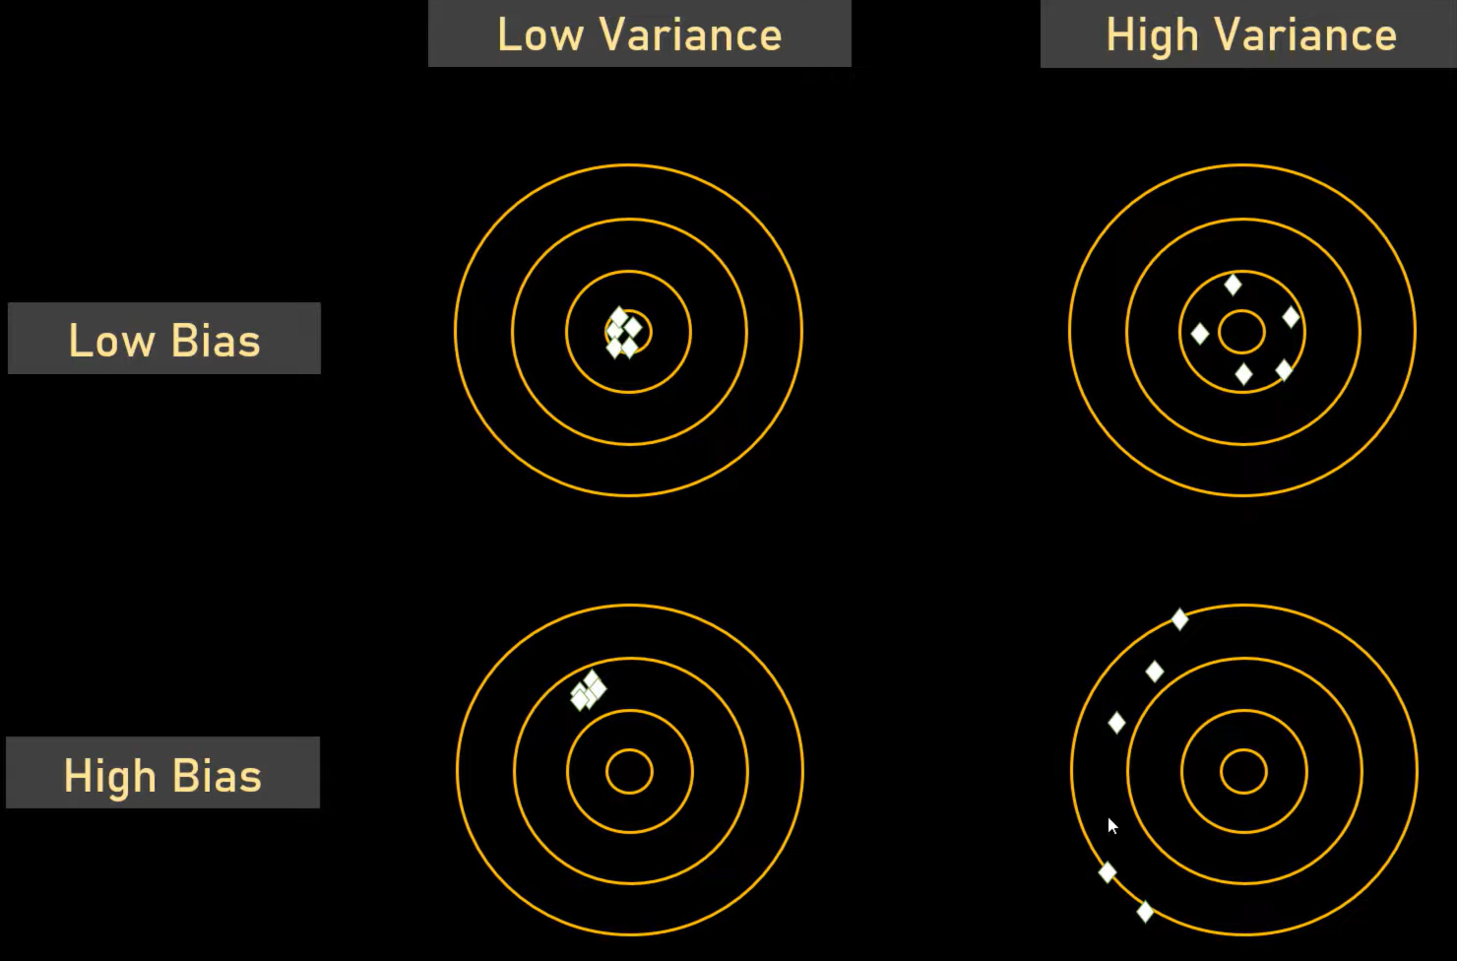
Bias-Variance Tradeoff
Central circles represents TRUTH and white diamonds represents predicted values.
Inner circle means low bias. Far away from Middle Circle = High Bias
When diamonds clustered together = Low Variance, when scattered = High Variance.

Slide 56
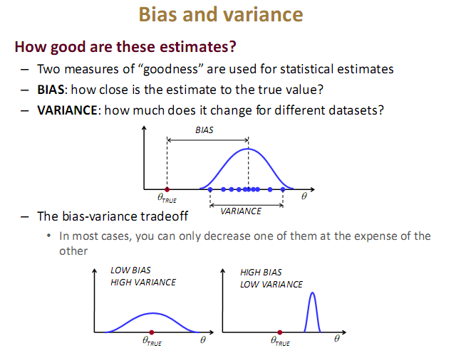

Slide 57
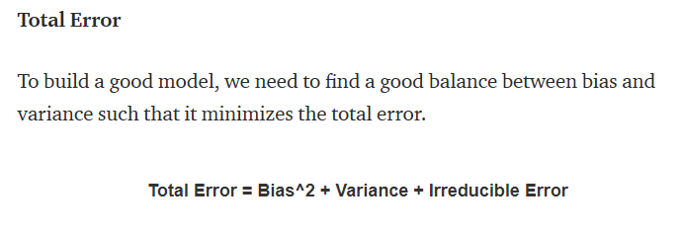
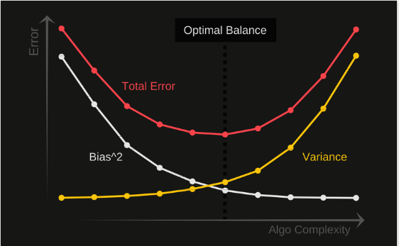

Slide 58
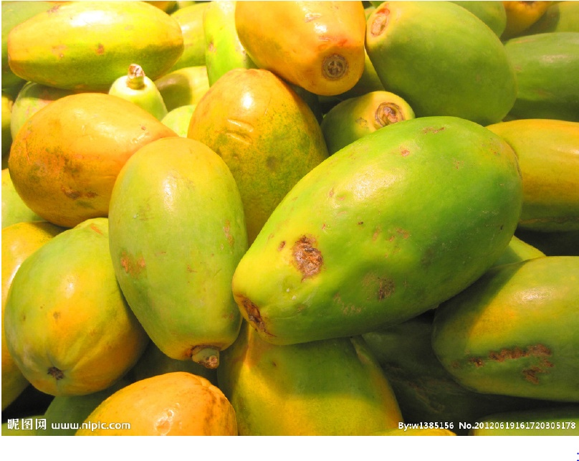
Learning Theory
Let us begin our mathematical analysis by showing how successful learning can be achieved in a relatively simplified setting.
Imagine you have just arrived in some small Pacific island. You soon find out that papayas are a significant ingredient in the local diet. However, you have never before tasted papayas.
You have to learn how to predict whether a papaya you see in the market is tasty or not.
you need to decide which features of a papaya your prediction should be based on.
On the basis of your previous experience with other fruits, you decide to use two features:
the papaya’s color, ranging from dark green, through orange red to dark brown,
and the papaya’s softness, ranging from rock hard to mushy.

Slide 59
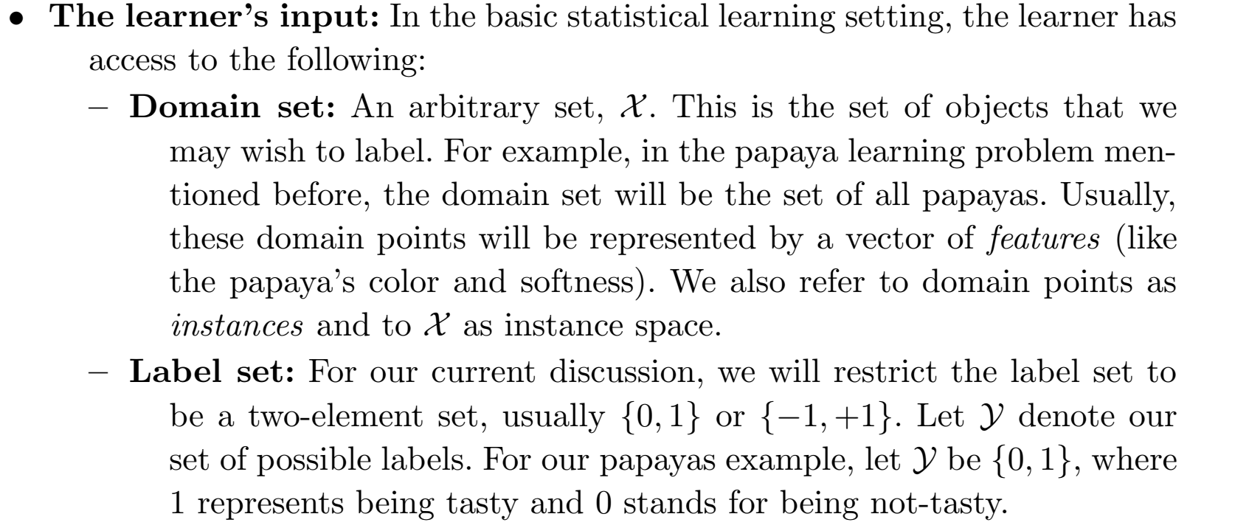
A Formal Model The Statistical Learning Framework
X (Input) Domain Set
Y (Target) Label Set

Slide 60
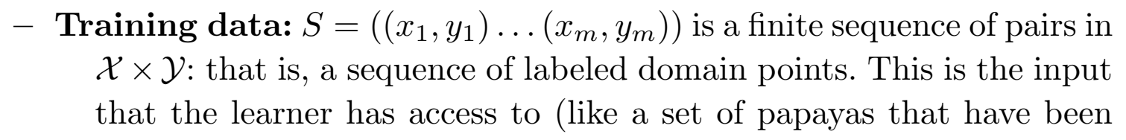


A Formal Model The Statistical Learning Framework
X+Y (Input + Target combined) = Training Set S
is hypothesis or Model or Classification Rule

Slide 61

A Formal Model The Statistical Learning Framework
Input X came from Universe / environment (Distribution) and is called D
f is called true learning function
True function f and distribution D is unknown to trainer.
Trainer only knows only input X and hypothesis h
If h=f, best case i.e. correct prediction

Slide 62



A Formal Model The Statistical Learning Framework
Distribution D is unknown, h(x) is output of our model, f(x) is target
L is Loss function (true error) and is unknown

Slide 63


A Formal Model The Statistical Learning Framework
f is true learning function

Slide 64

Sample Error and True Error
The sample error of a hypothesis with respect to some sample S of instances drawn from X is the fraction of S that it misclassifies:

Slide 65

Sample Error and True Error
The true error of a hypothesis is the probability that it will misclassify a single randomly drawn instance from the distribution D.

Slide 66

Sample Error and True Error
Sample error is 30%
0-1 Loss Function
0 Loss = Correctly Classified (28 times)
1 loss = Misclassified (12 times)

Slide 67


Confidence Intervals for Discrete-Valued Hypotheses
Measurement of True Error
Eq. 5.1 gives sample error
Distribution is Normal Distribution
Central Limit Theorem is generally used for calculation of the true error

Slide 68

Confidence Intervals for Discrete-Valued Hypotheses
we wish to estimate the true error for some discrete valued hypothesis h, based on its observed sample error over a sample S,
where the sample S contains n examples drawn independent of one another, and independent of h, according to the probability distribution V
n ≥ 3 0
hypothesis h commits r errors over these n examples (i.e., errors(h) = rln).
Under these conditions, statistical theory allows us to make the following assertions:
In the current example, where r = 12 and n = 40, the 95% confidence interval is,
according to the above expression.
Instead of calculating sample and true error, we generally divide data into training data and testing data. Training error is sample error and testing error is true error as the data is from the same distribution.

Slide 69

BASICS OF SAMPLING THEORY

Slide 70


Mean and Variance

Slide 71

Error Estimation and Estimating Binomial Proportions

Slide 72


Estimators Bias, and Variance

Slide 73



We want best hypothesis over a distribution D but D is unknown. A sample from D is known. Empirical Risk Minimization says that the best in sample will be best in whole distribution. But Actually it is Not Necessary.
L is training error, xi is output and yi is target. M is number of samples. E.g. 12/40=0.3

Slide 74

ERM says that we should consider that hypothesis for which training error is least. (Best in training will perform best in testing)
The above principle is called ERM
But, It is not always true. So some problem may be there… and is called Overfitting.

Slide 75


Slide 76

Overfitting
Underfitting: neither model the training data nor generalize the new data.

Slide 77



Empirical Risk Minimization Example
f: Sky → Weather
Kevin hates getting rained on.
Sarah hates to carry an umberalla.

Slide 78


Inductive Bias means prior knowledge. ERM works well with Inductive Bias. E.g. If a students track record is also good apart from good performance in the current class, he can be expected to perform well in future also.

Slide 79


ERM hypothesis is one with minimum loss on training sample.

Slide 80



LD is true error. hs is ERM hypothesis. There can be Approximation error or Estimation Error.

Slide 81





Slide 82

Estimation error increases if sample is large.

Slide 83


Slide 84
Why Prefer Short Hypotheses?
Occam's razor: Prefer the simplest hypothesis that fits the data.
there are fewer short hypotheses than long ones (based on straightforward combinatorial arguments), it is less likely that one will find a short hypothesis that coincidentally fits the training data. In contrast there are often many very complex hypotheses that fit the current training data but fail to generalize correctly to subsequent data.
The difficulty here is that
there are very many small sets of hypotheses that one can define-most of them rather arcane.
the size of a hypothesis is determined by the particular representation used internally by the learner.

Slide 85
Thank You !!!

